Slide 1
Succession with Purpose: Purpose Trusts as a Tool for Business Succession Planning
Susan N. Gary
University of Oregon
South Dakota Trust Association
October 17, 2024
OGC slides created by Natalie Reitman-White, Purpose Owned

Slide 2
Business Succession Challenges
No children to take over the business
Business may be difficult to sell as an on-going business
Sale of the business may result in changes in the way the business is run
Focus on employee welfare
Operation with concern for environmental impacts
Community located and community focused
If business is sold, buyer might move the business or shut it down

Slide 4
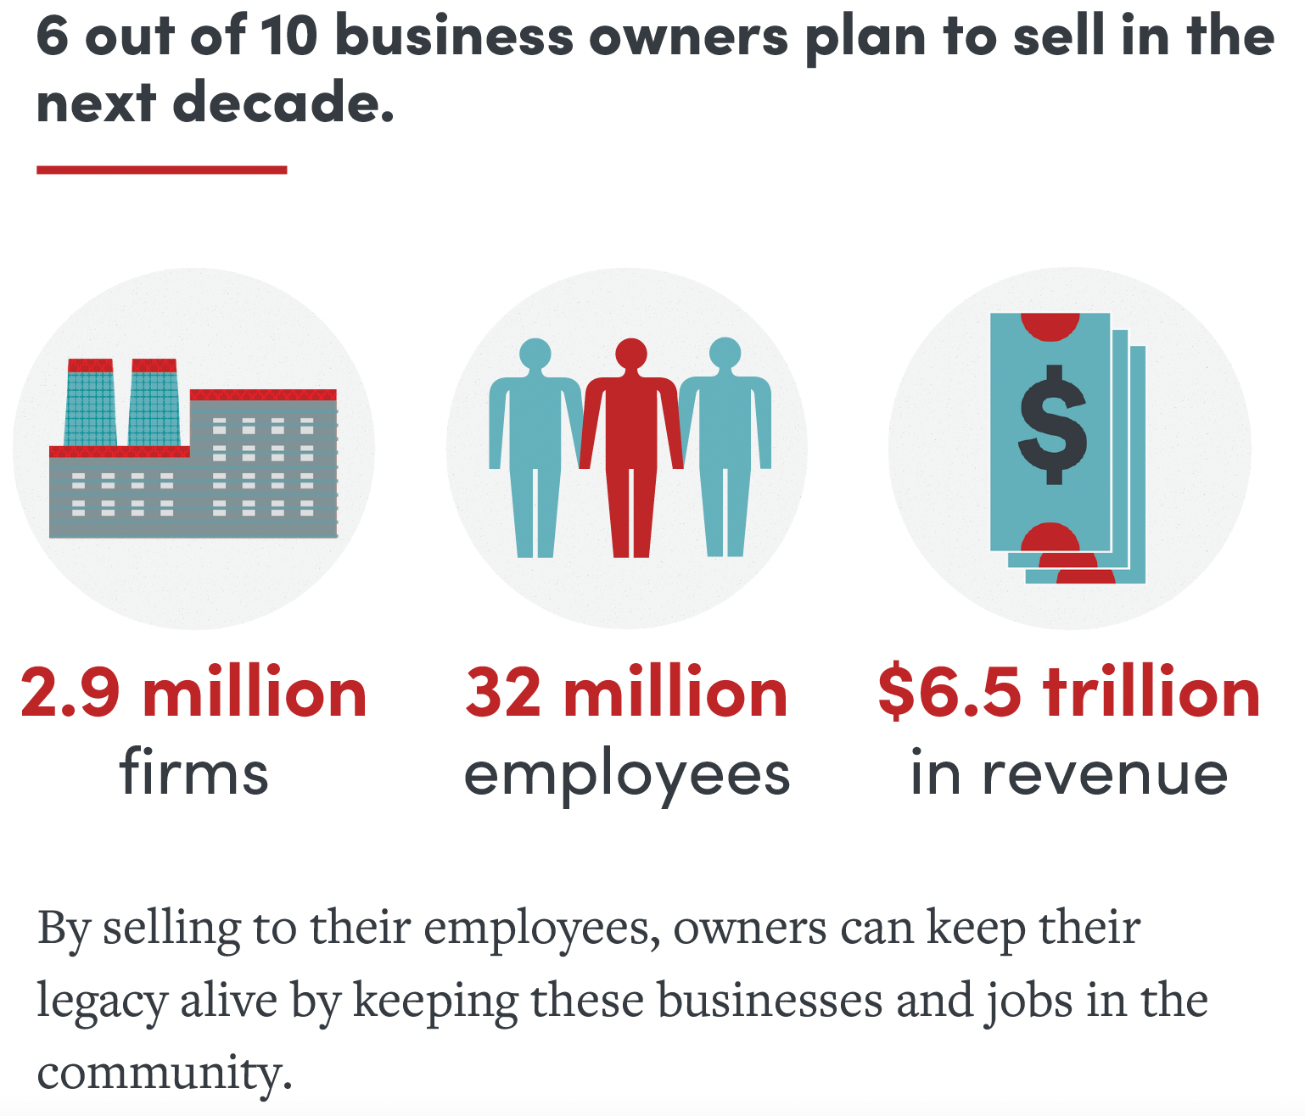
Baby boomers own over half of all privately held firms in the United States

Slide 5
Why a Purpose Trust Structure Might Help
Keep the business going
Keep jobs in the community
Continue operation of the business in line with the founder’s values
Provide money from a sale for the founder’s retirement or to provide an on-going income stream for descendants.

Slide 6
What Is a Purpose Trust
No beneficiaries – a trust for a purpose, which in this case is to own and manage a business
Not charitable, but it can be combined with a charitable entity or a 501(c)(4) social welfare entity
Perpetual – the purpose trust should be established in a state that permits it to exist in perpetuity or for a very long time (these trusts are often called “Perpetual Purpose Trusts”

Slide 7
What State Law Rules Support This
UTC § 409, enacted in a majority of states, provides for purpose trusts, but:
Rule against perpetuities can be a problem
Court can reduce amount held in trust - § 409(a)(3)
Delaware adopted § 409, and:
allows a perpetual purpose trust
with no authority for court to reduce amount in trust
Oregon has a special form of purpose trust called a Stewardship Trust
Or. Rev. Stat. § 130.193 (2019)
Available for “any business purpose”
Requires a 3-person stewardship committee and provides default rules for the trust
Other states (Illinois, Wisconsin) are considering legislation

Slide 8
South Dakota
S.D. Codified Laws Secs. 55-1-20
Any lawful noncharitable purpose
The common law rule against perpetuities does not apply
S.D. Codified Laws Secs. 55-1-21.3
“If the court finds that the fulfillment of the purposes are or have become impossible, inexpedient, or unlawful, the court shall make an order directing that the trust be administered in such manner as, in the judgment of the court, will, as nearly as can be, accomplish the general purposes, the objects, and intentions of the trustor.”

Slide 9
Why Use a Purpose Trust
Business founders ready for retirement may want to ensure the continuity of the business operations and may want the mission of the business to continue as their legacy
Business founders may want to protect the employees and ensure that the business operates in an environmentally conscious manner
A family business may want to protect the business as it transitions to successor generations and avoid loss of family control if successor generations lose ownership (stock) due to divorce or other creditors
Business founder may want to provide children and further descendants with an income stream rather than one big “pay day”
A new business may want a structure that focuses on mission

Slide 10
Governance Structure
No beneficiaries
A trustee – often a corporate trustee with limited power but an individual trustee can work
A stewardship committee (management committee) made of representatives from stakeholder groups
A trust enforcer

Slide 11
Tax Treatment – Trust Income Tax
Probably a complex trust; irrevocable trust – pays tax at trust tax rate § 1(e) – but no beneficiaries so tax regulations are not clear
If trust income (usually dividends from company owned) = deductions (usually expenses needed to operate trust), then no taxable income

Slide 12
Tax Treatment on Transfer to Trust
If owner donates shares, then transfer tax applies to value of donation.
Federal and state gift or estate taxes
Some states impose an estate tax but not a gift tax (e.g. Oregon)
If owner sells shares, founder will have capital gains.
Owner should avoid “control” of trust or company to keep transfer by gift out of owner’s estate. § 2036.

Slide 13
Perpetual Purpose Trust
Noncharitable, irrevocable purpose trust, with no beneficiaries
Management and oversight provided through a trust stewardship committee
Trust purpose enforced through a trust enforcer
Company can
focus on reinvestment in ongoing business operations
share profits and growth with selected stakeholders
generate capital through preferred non-voting stock
No need for liquidity – no owners who want to sell stock
Trust structure protects mission (purpose) indefinitely
Trust instrument can provide specific terms, flexibility
Family can continue to work in business, receive dividends as nonvoting shareholders

Slide 14
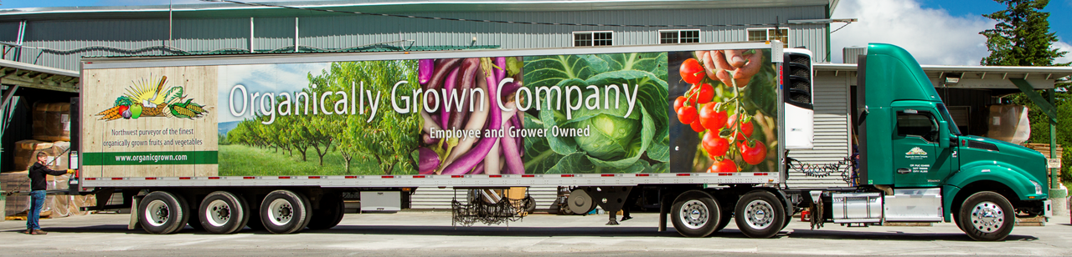
EXAMPLE: Organically Grown Company (OGC)
Largest organic produce distributor in Pacific Northwest; 250 employees, 500+ customers, 800+ suppliers.
Mission-driven shareholders and staff; history of activism and triple bottom line focus – “Our goal is to support organic agriculture and help it thrive, by doing business in a way that is ‘good, clean and fair.’”
Multiple business forms over 40 years: nonprofit; producer cooperative; Subchapter S; and Sub S + ESOP
Concerned with providing liquidity event for shareholders while maintaining independence to pursue mission

Slide 15
OGC’s Objectives
Legacy stockholders wanted/needed liquidity
Desire to focus on operation of business and use of its income for benefit of mission and multiple stakeholders
Goals: local control, independence, and on-going operation rather than liquidity events for stockholders

Slide 16
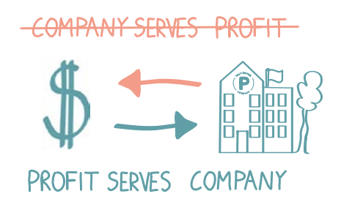
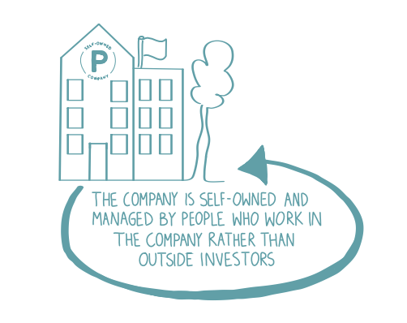
Key Features: Stewardship Trust (perpetual purpose trust)
Designed to hold company ownership for the long-term.
As the majority owner, the Trust does not expect to extract a profit, nor is its goal to maximize its stock value in preparation for an “exit” since the trust intends to hold the company stock into perpetuity. Thus, eliminates the need to have ongoing energy spent on finding vehicles for liquidity “exit” for past owners.
Instead, the Trust directs the company leadership to reinvest the profits to keep the business healthy and viable, while focusing on serving its mission and stakeholder community.
Notes:
Turns traditional ownership on it’s head….

Slide 17
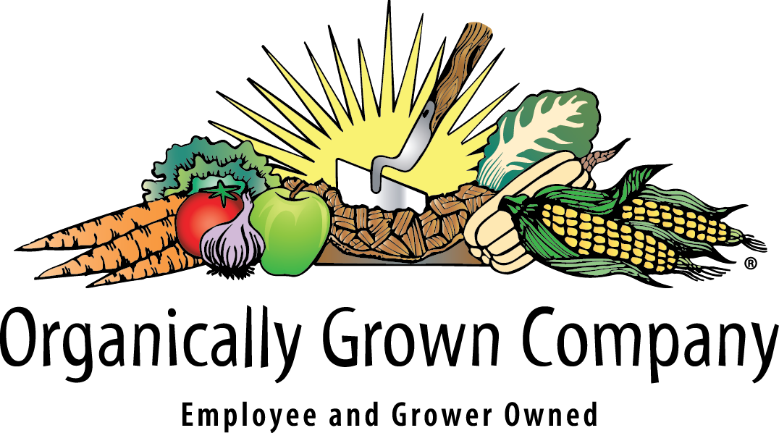
Stewardship Trust Ownership of Operating Company
The trust holds 100% of common stock in perpetuity with “no exit.” The trust is a “steward-owner” that ensures continuity of operations to purpose.
The Sustainable Food + Agriculture
Perpetual Purpose Trust (SFAPPT)
Owns and controls
c-corp Oregon Benefit Company
Notes:
Post Conversion
Basic structure, Purpose Trust rather than people owns 100% of company, company is a c-corp benefit corp.
•
Optional can allow inroad for aligned long-term investment at the company level w/out giving up control or tipping the balance of governance towards investors maximization away from mission (we’ll talk about how we structure that next).

Slide 18
Financing Flows During the OGC Conversion Process to Trust Ownership, 2018 - 2021
Acquires shares and eventually holds 100% common stock
Institutional Loan (RSF Social Finance)
Trust
Obtain, then
pay down
Preferred Shareholders (private placement mission aligned investors)
Non-voting investors receive
annual dividend (~ 5-8% target)
Buy Back Shares
Minority Common Stock (exiting shareholders founding farmers & employees)
Share rewards
Stakeholders:
Employees, farmers, customers, community allies
May invest profit share in preferred stock
Notes:
DELETE SLIDE FOR ESOP DECK?
There is a period of financing the transition that looks like this.
First take out a loan with RSF Social Finance very mission aligned—invested in VV, East Carolina Organics, Hummingbird, Guyaki, Lotus Foods, etc.
The Trust now has more than ½ the shares to start.
Raise non-voting perfered stock from aligned community investors, as that $ comes in, pay down the loan and the miniorty shareholders.
Both minority stock shareholders and ESOP participants, up to 35 non-accredited can reinvest through preferred stock—initially small group higher minimum, overtime we are looking for ways to expand.
In the end Trust is 100%, other shareholders exit and loan paid off.
Modeled stakeholder rewards based on profitability that rise overtime as loan and shareholders are paid down.

Slide 19
2. Financial Flows: Profits serve purpose
Income Flows: Profits Serve Purpose
The Sustainable Food + Agriculture
Perpetual Purpose Trust (SFTPPT)
Company provides minimal
budget to administer trust
OGC investors receive
annual dividend/profit sharing but have no voting rights and no rights to sell the company
Non-voting Preferred Shareholders
Profits reinvested in company & stakeholders:
Employees, farmers, community allies, customers
Notes:
Matt
Here is how financial flows work once fully established, since there is no longer exit to pay to shareholders (get of the treadmill) we can use $ for other things.
We got the preferred stock idea from our co-op friends (OV, Equal Exchange, Namaste).
For us we used modeling to establish our sweet spot through a cash flow waterfall of what we can pay, and still keep most focused reinvestment mission & stakeholders.

Slide 20
GOVERNANCE AND OWNERSHIP
OF ORGANICALLY GROWN COMPANY
Trust Stewardship Committee
Trustee
Trust Enforcer
Power to remove
and replace
Power to elect and remove
Board of Directors
Stakeholder
representative
Stakeholder
representative
Stakeholder representative
Sustainable Food and Agriculture Perpetual Purpose Trust
majority ownership & VOTING CONTROL
Organically Grown Company
Community
Non-Voting Preferred Stockholders
Customers
Producers
Employees

Slide 21
Governance
Stakeholders:
Qualified employees, farmers, customers, community allies, investors.
Stewardship Committee
Act as stewards of the ownership. Ensure Trust fufills its purpose.
Trustee
Carries out administrative functions of the trust
elect
oversees
administers / enforces
Trust Enforcer
Acts only a rare event there is a dispute
Trust
appoint
owns
OGC Board
Works with CEO & management to ensure sound operations and strategic plans that deliver measurable results toward the company mission.
Preferred Shareholders
oversees
Non-voting stock
Engaged along side other stakeholders to ensure stewardship of the Trust.

Slide 22
Qualified Stakeholders:OGC
Active Participants with an Interest in OGC
Suppliers | Farmers that have built a positive supply relationship with OGC over time.
Employees | Coworkers with company tenure, an understanding of OGC’s governance and demonstrated company engagement.
Purchasers | Select accounts with a history of steady business with OGC.
Community | Select nonprofits and OGC trade allies.
Preferred Stockholders | Mission Aligned investors.
Trust Enforcer
enforces
Trust Agreement
governs
Trust
administers
Trustee
enforces
stewards
owns
Qualified Stakeholders
elect
Stewardship committee
appoints
OGC Board of Directors
oversees
Organically Grown Co.
Invest in
Preferred Shareholders
Notes:
Suppliers
All active growers with an average of over $18K in COG sales to OGC for at least 3 years. Excludes account managed purchasing programs and brokers. Additionally, OGC must be exclusive distributor of grower’s product within our primary active distribution areas and the growers sales to OGC must represent 20% or more of their overall fresh sales.
Employees
Tenure of 3 years and in good standing
Expression interest
Participation requirement (i.e. annual meetings, committee service)
Test to include questions on governance structure, business fundamentals, purpose, mission, etc.
Coworker committee to meet with interested stakeholders to review/discuss expressions of interest
Final approval from BOD and/or TPC
Customers
TBD
Community
Select nonprofit and OGC trade allies. TBD.

Slide 23
Benefits of Purpose Trust as a Business Structure
Family
Can continue as employees
Can receive dividends as nonvoting shareholders (e.g. Bosch)
Can have a voice through a representative on the management committee (be careful about a retained interest if the transfer is by gift)
Protects company from dilution of control as family grows (cousins don’t agree, next gen divorces cause loss of control)
Employees
Employees have a voice through a representative on the management committee (e.g. John Lewis Partnership)
Financial benefits – profit-sharing, better wages and conditions
Jobs protected if business continues

Slide 24
Benefits of Purpose Trust as a Business Structure
Survival of Business in the Community
No need to worry about shareholder exit
No need to worry about a hostile takeover (cf. ESOP)
No need to worry about a buyer moving the business out of the community
No need to worry about a competitor buying the business to close it
Less complicated than an ESOP
Easier to set up
No ongoing valuation requirements
Vision and Values – Profit Serves Purpose
Company maintains its business purpose and mission into future
Terms of the trust can protect the founder’s way of doing business
Trust structure can protect the quality of goods or services
The business can be the founder’s legacy

Slide 25
Challenges of Using a Purpose Trust
Transition Costs
Legal fees and other transition costs
If a gift, transfer tax concerns
If a sale, tax concerns and funding concerns
Fiduciaries
Who should serve on management committee – which stakeholders
Who should serve as trustee – some banks are reluctant
How will successor fiduciaries be chosen
Protection for directed trustees
Building in Vision without Constraining Development
Terms of trust should set values and overall purposes
The business itself can change and develop within the framework set up in the trust agreement

Slide 26
Funding a Sale
Retained earnings
Document business purpose for retained earnings to avoid accumulations tax
Loan
Social finance loan for a business with a social or environmental mission
Conventional loans may be an option, but lenders need to understand why/how this works
Installment Sale
Use earnings
Nonvoting Preferred Stock
Former shareholders or family members of founder
Impact investors

Slide 27
Transfer Strategies – If Owner Has Charitable Interests
Combine trust with a 501(c)(3) or 501(c)(4) entity
Give all voting stock to the purpose trust
Give all or some of the nonvoting stock to a (c)(3) or (c)(4) entity
Patagonia Purpose Trust owns voting shares valued at 2% of Patagonia;
Holdfast Collective (a 501(c)(4) org) owns nonvoting dividend shares valued at 98%
Put business in the trust and give other assets (real estate) to a 501(c)(3) or (c)(4)

Slide 28
“Earth is now our only shareholder.”
Yvonne Chouinard and family (spouse and two adult children) owned the company. The children wanted to stay involved but did not want to own the company.
The Patagonia website explains:
“The Patagonia Purpose Trust was created solely to protect our company’s values and mission. It owns all of the voting stock of the company, which gives it the right to approve key company decisions, like who sits on the board of directors and what changes can be made to the company’s legal charter, including its reason for being and B Corp commitments.” “Put another way, Patagonia’s purpose is: We’re in business to save our home planet. The Patagonia Purpose Trust ensures the company’s commitment to its purpose forever.”

Slide 29
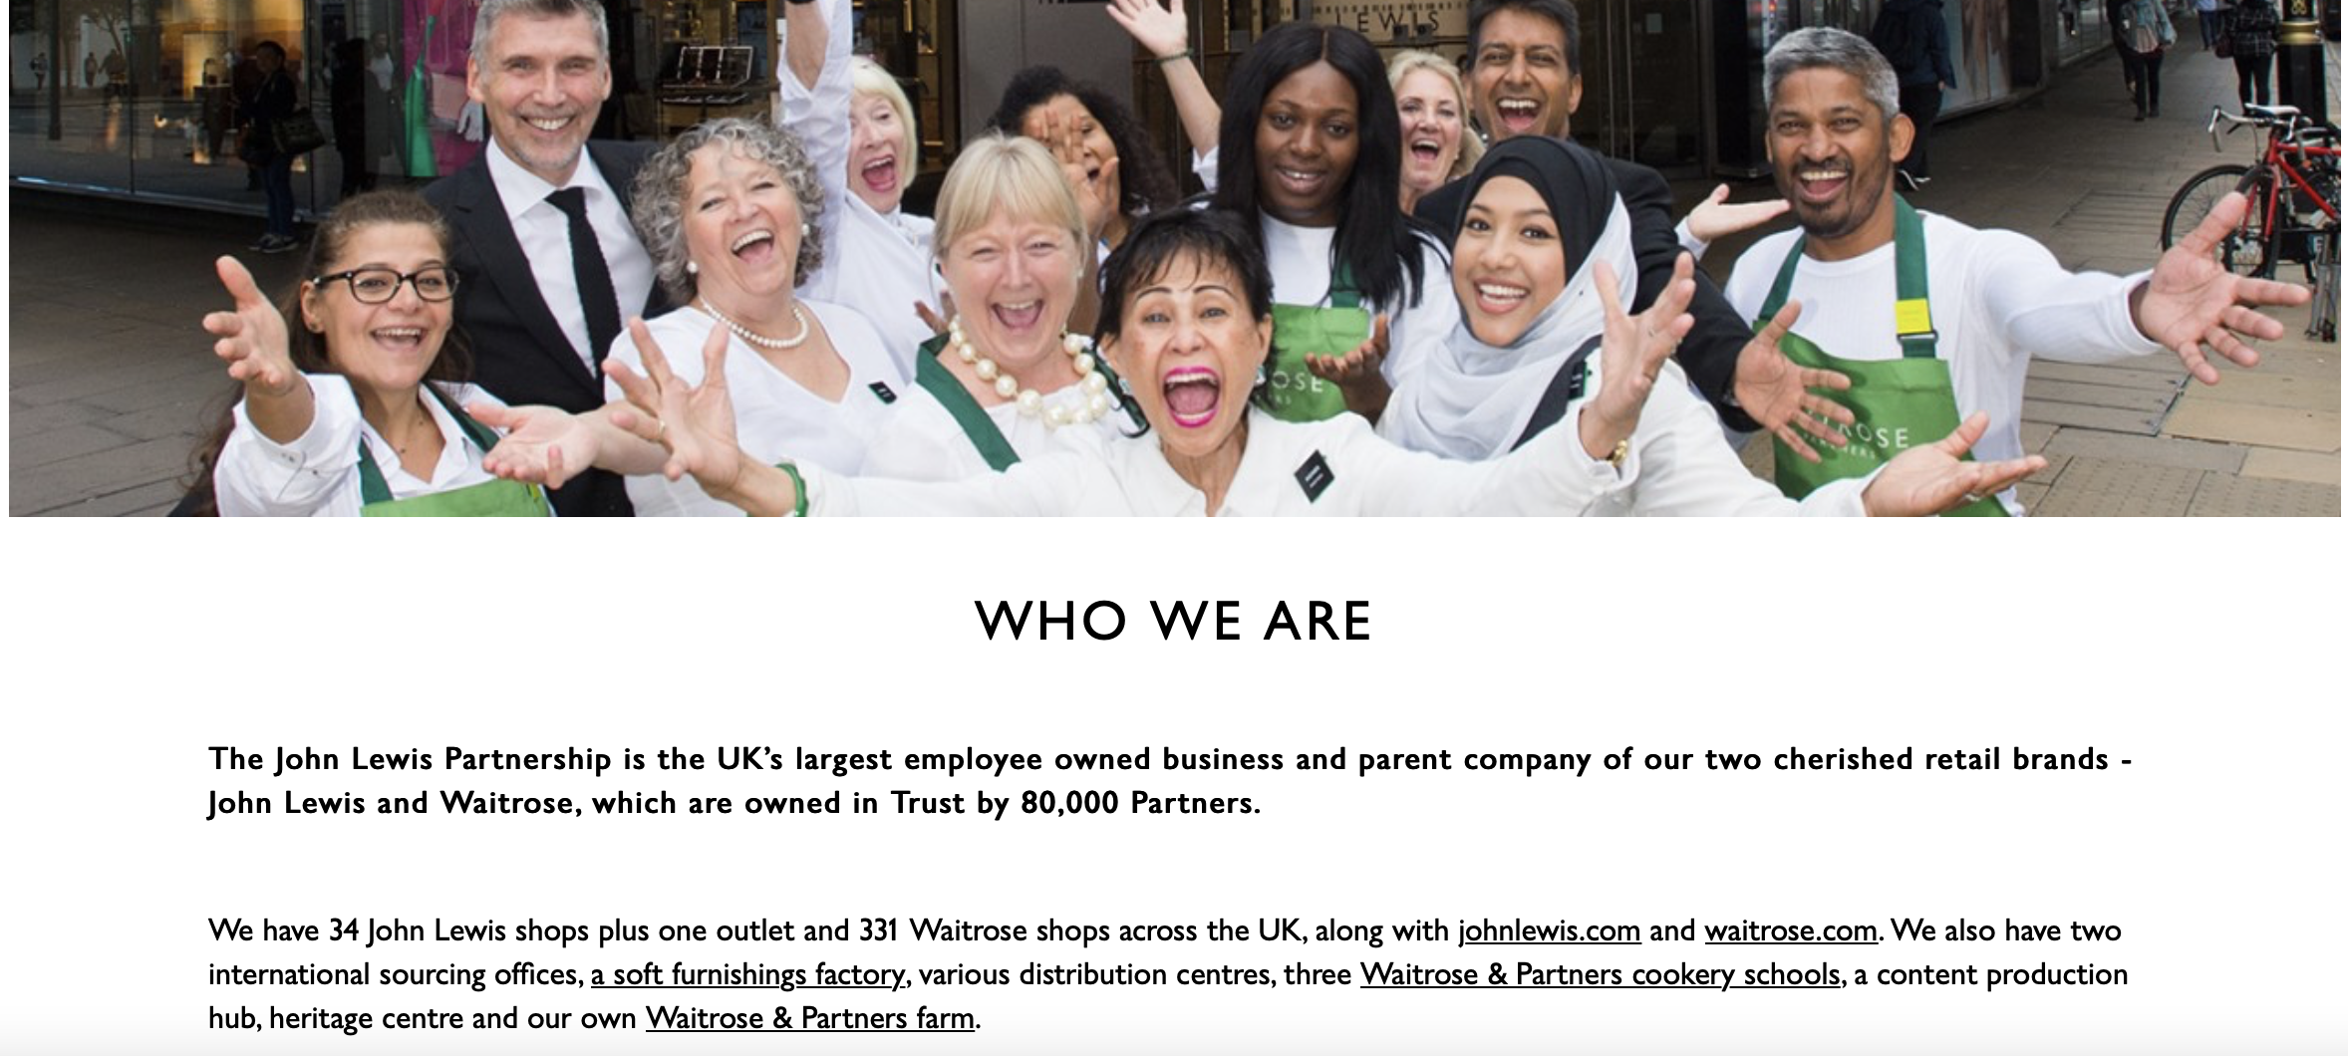
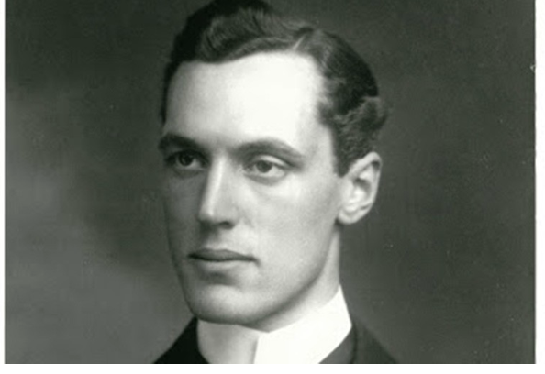
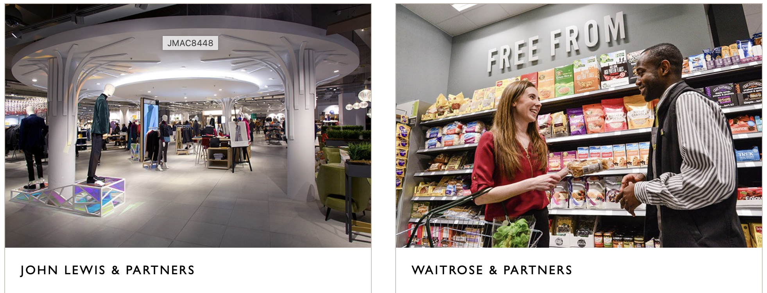
John Spedan Lewis (1914)

Slide 30
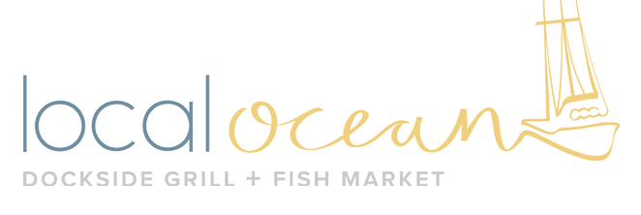
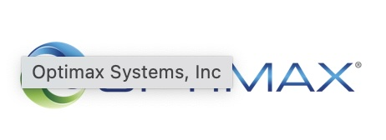

Slide 31
On Nov. 18, 2023, Gavin McComas donated his ownership of Sundance Natural Foods to the newly formed Sundance Perpetual Purpose Stewardship Trust (SPPST).

Slide 32
For More Information
Susan Gary – sgary@uoregon.edu
Natalie Reitman-White – Purpose Owned LLC
Articles:
Susan N. Gary, The Changing Landscape of Business Succession: How and Why Purpose Trusts Matter, 18 Ohio State Bus. L. J. 41 (2024) (https://papers.ssrn.com/sol3/papers.cfm?abstract_id=4551502).
Susan N. Gary, The Oregon Stewardship Trust: A New Type of Purpose Trust that Enables Steward-Ownership of a Business, 88 Univ. of Cincinnati L. Rev. 707 (2019) (symposium on The Business Uses of Trusts) (SSRN: http://ssrn.com/abstract=3426845).
Susan N. Gary, The Need for a New Type of Purpose Trust, the Stewardship Trust, 45 ACTEC Law J. 701 (2019).
Ellen K. Harrison, Purpose Trusts and Steward Ownership, 112 Tax Notes State 561-70 (May 20, 2024)

